Slide 1

Vel Tech Rangarajan Dr. Sagunthala R&D Institute of Science and Technology
School of Computing
Department of Computer Science and Engineering
10211CS224 / FULL STACK APPLICATION DEVELOPMENT (JAVA)
END SEMESTER PROJECT REVIEW
Date: 06-05-2026
Ticket Booking Platform
SDG: 9 – Industry , Innovation and Infrastructure
Presented By:
S.Jishnu Parameswararao – VTU26604 – 23UECS0877
Courses Handling Faculty:
Dr. Hafizur Rahman – Assistant professor

Slide 2
INTRODUCTION
1
Background of the problem:
Manual ticket booking systems lack automation and real-time seat management.
Why this project is important:
It simplifies ticket booking and provides instant confirmation with reduced errors.
Real-world relevance:
Useful for managing departmental events like technical fests, seminars, and workshops.
Brief overview of the system:
Useful for managing departmental events like technical fests, seminars, and workshops
2
3
4
5
6
7
8
9

Slide 3
PROBLEM STATEMENT
In many educational institutions, event ticket booking and registration processes are still handled manually, which consumes more time and increases the chances of errors in maintaining records. Manual systems often lead to problems such as overbooking, incorrect data entry, and difficulty in tracking booking details. Users may also face inconvenience in receiving booking confirmation and accessing booking history. There is a need for a simple, reliable, and automated ticket booking system that can efficiently manage event registrations, validate user inputs, maintain booking records, and provide a smooth and user-friendly booking experience through an online platform.
1
2
3
4
5
6
7
8
9

Slide 4
OBJECTIVE(S)
To develop a user-friendly web application for online event ticket booking using React JS.
To validate user inputs and prevent overbooking during ticket reservation.
To provide booking confirmation and maintain booking history efficiently.
1
2
3
4
5
6
7
8
9

Slide 5
PROPOSED SYSTEM
The proposed system is a web-based Event Ticket Booking System developed using React JS.
It allows users to view event details and book tickets online easily.
The system validates user inputs to avoid incorrect data entry.
It prevents overbooking by checking ticket availability dynamically.
Users receive instant booking confirmation and booking summary.
Booking history is maintained using browser local storage.
The system reduces manual effort and improves booking efficiency.
Compared to manual systems, it provides faster processing, better accuracy, and improved user experience.
1
2
3
4
5
6
7
8
9

Slide 6
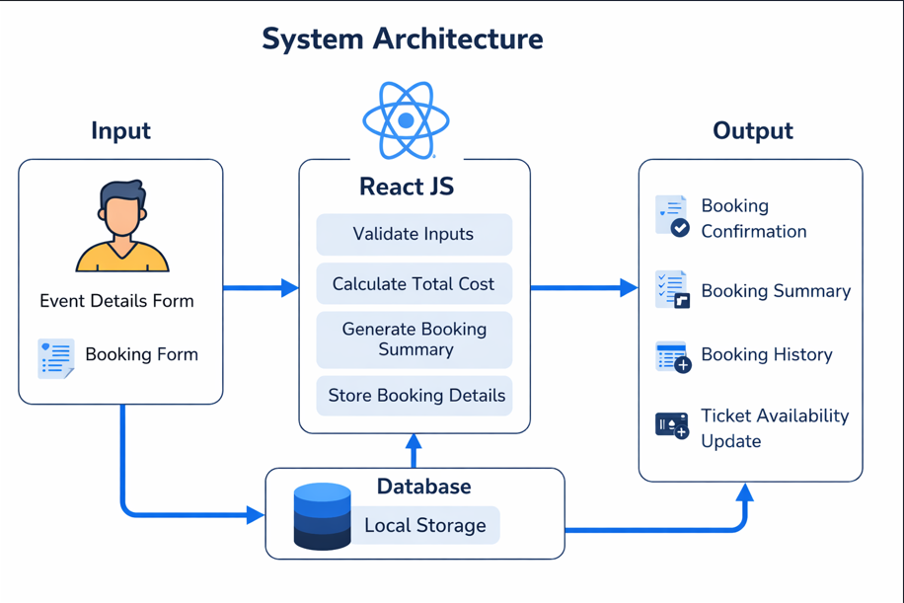
PROPOSED SYSTEM ARCHITECTURE
1
2
3
4
5
6
7
8
9

Slide 7
PROPOSED SYSTEM ARCHITECTURE
1
Inputs (User-facing forms):
Event Details Form
Booking Form
Storage:
Local Storage (browser-based DB): Handles bookings, history, availability. No backend/server shown.
Outputs:
Booking Confirmation
Booking Summary
Booking History
React JS Core Logic:
Validate Inputs: Checks form data (e.g., required fields, dates, quantities).
Calculate Total Cost: Computes price based on tickets, fees, etc.
Generate Booking Summary: Creates a preview/summary.
Store Booking Details: Saves to local storage.
Ticket Availability Update
2
3
4
5
6
7
8
9

Slide 8
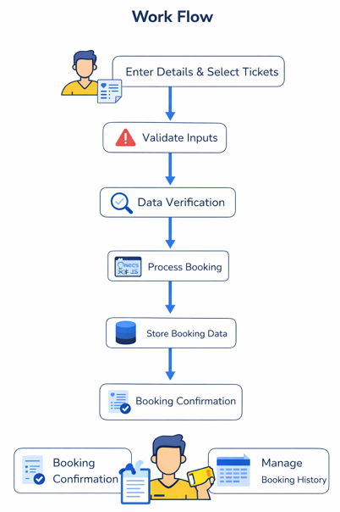
WORKFLOW
1
2
3
4
5
6
7
8
9

Slide 9
TECHNOLOGIES USED
Frontend: React JS, HTML5, CSS3, JavaScript (ES6)
Backend: No separate backend used (Frontend-based application)
Database: Browser Local Storage
Third-Party API: EmailJS (for booking confirmation emails)
Tools: Visual Studio Code, Node.js, npm, Google Chrome
Hardware/Software Requirements: Windows 10/11, Minimum 4 GB RAM, Intel i3 Processor or above, Internet Browser, Node.js Installed System
1
2
3
4
5
6
7
8
9

Slide 10
MODULE DESCRIPTION
Module 1: Event Details Management
Handles displaying event information such as event name, department, venue, date, ticket price, and available tickets for users.
Module 2: Ticket Booking Processing
Implements the core booking functionality by collecting user details, validating inputs, checking ticket availability, and processing bookings.
Module 3: Booking Storage Management
Manages storing and retrieving booking details using browser local storage and maintains booking history efficiently.
Module 4: Email Confirmation & Validation
Handles input validation, displays user-friendly error messages, and sends booking confirmation emails using EmailJS integration.
Module 5: Booking Summary & History
Generates booking confirmation summary, displays booking details, and allows users to view or delete booking history records.
1
2
3
4
5
6
7
8
9

Slide 11
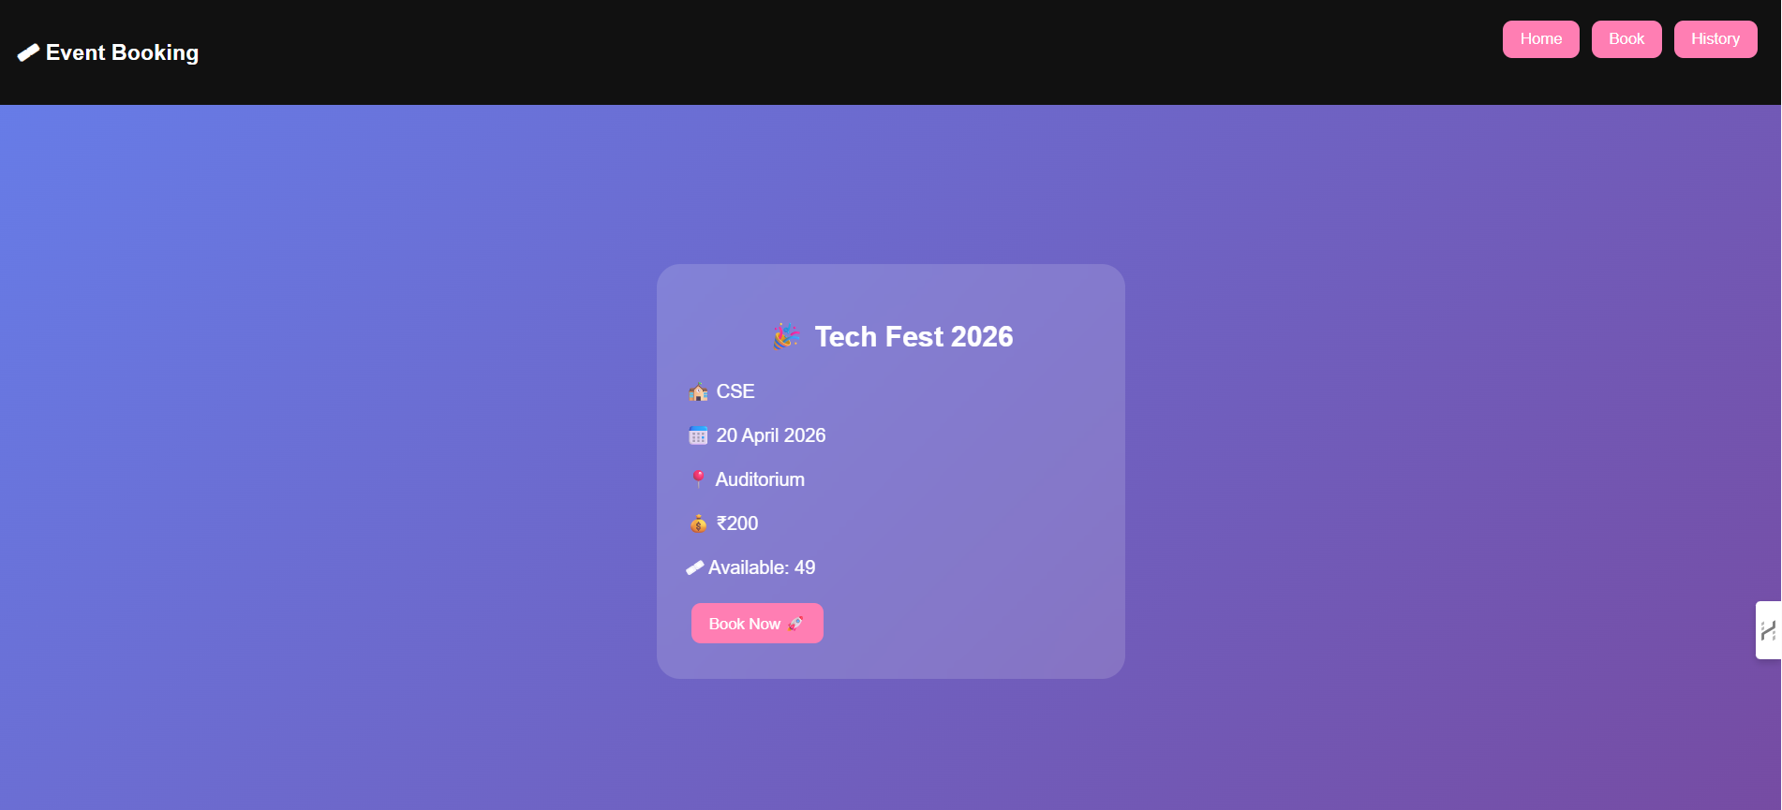
IMPLEMENTATION SCREENSHOTS
1
2
3
4
5
6
7
8(A)
9
This is an event booking page for Tech Fest 2026 showing details like date, venue, and price. Users can easily book tickets using the “Book Now” button.

Slide 12
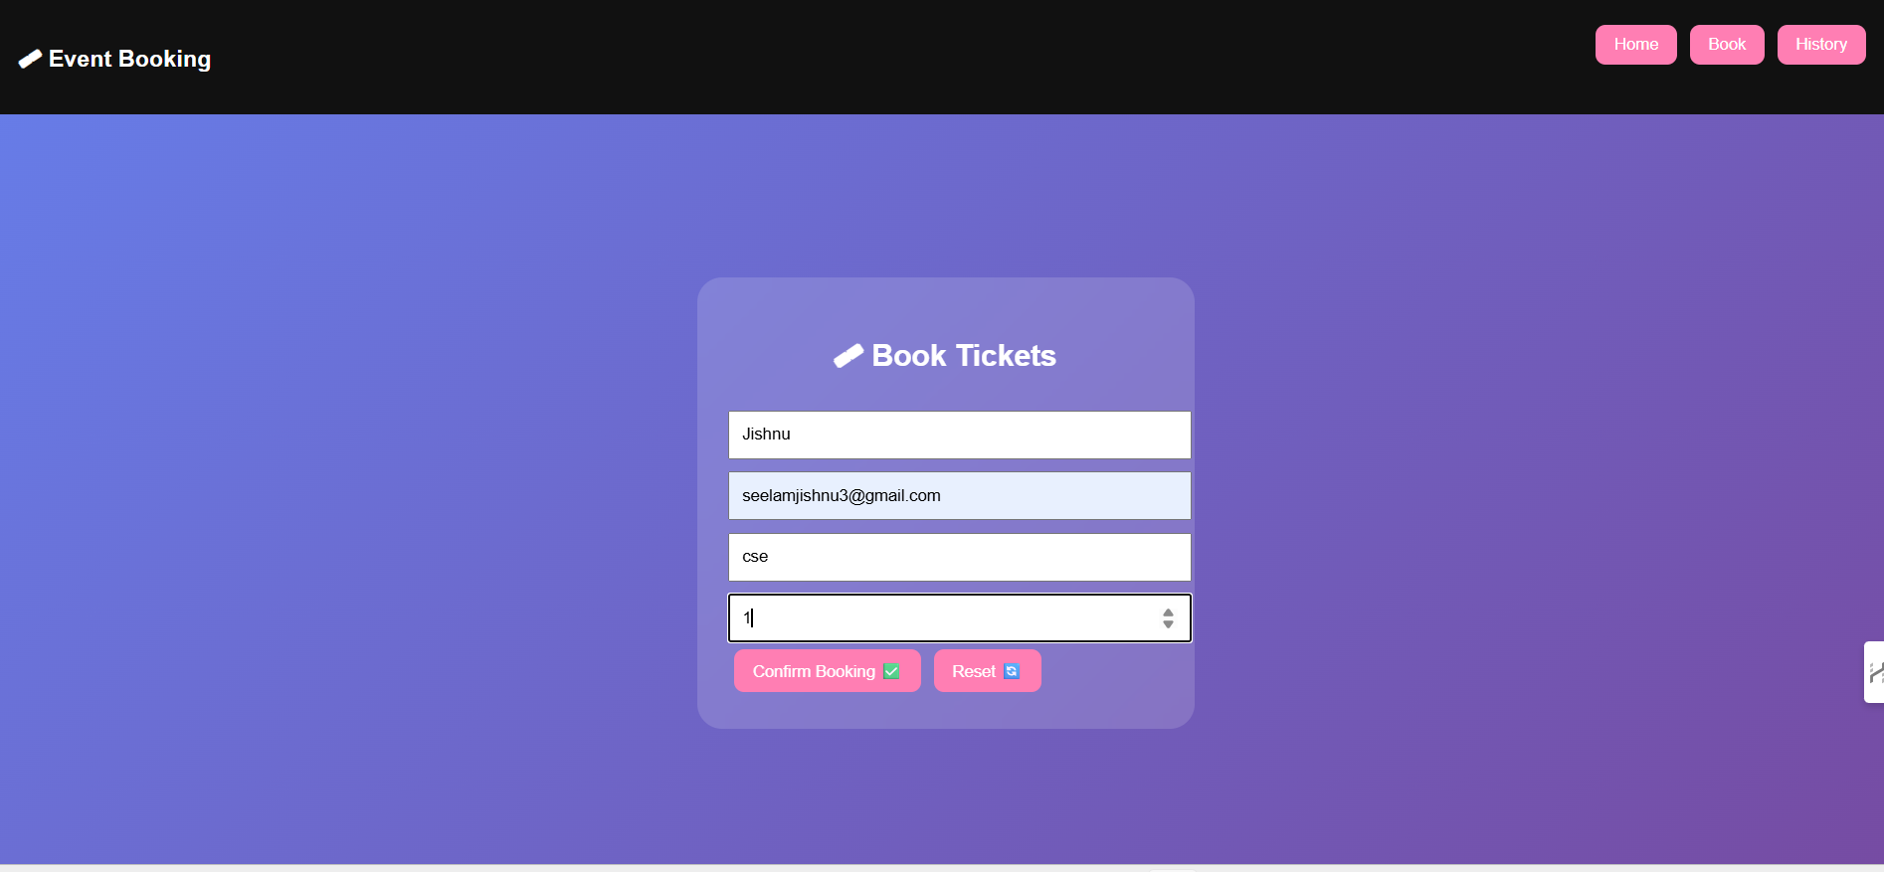
IMPLEMENTATION SCREENSHOTS
1
2
3
4
5
6
7
8(C)
9
This is a ticket booking form where users enter details like name, email, department, and number of tickets. Users can confirm their booking or reset the form easily.

Slide 13
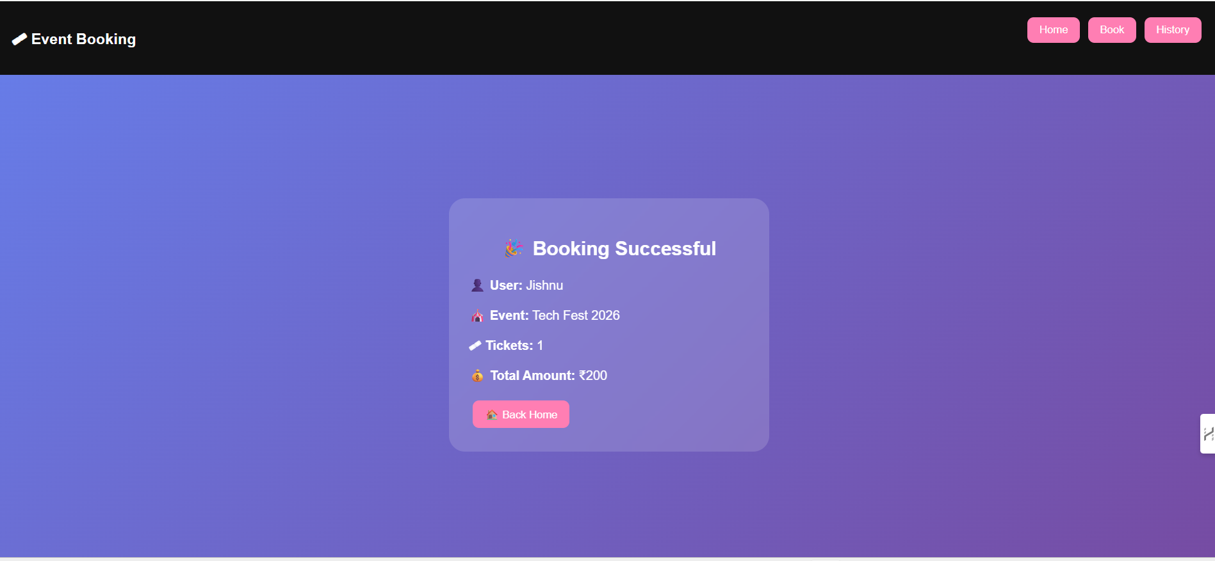
IMPLEMENTATION SCREENSHOTS
1
2
3
4
5
6
7
8(C)
9
This is a booking history page showing all the tickets booked by the user. Users can view details and delete any booking if needed.

Slide 14
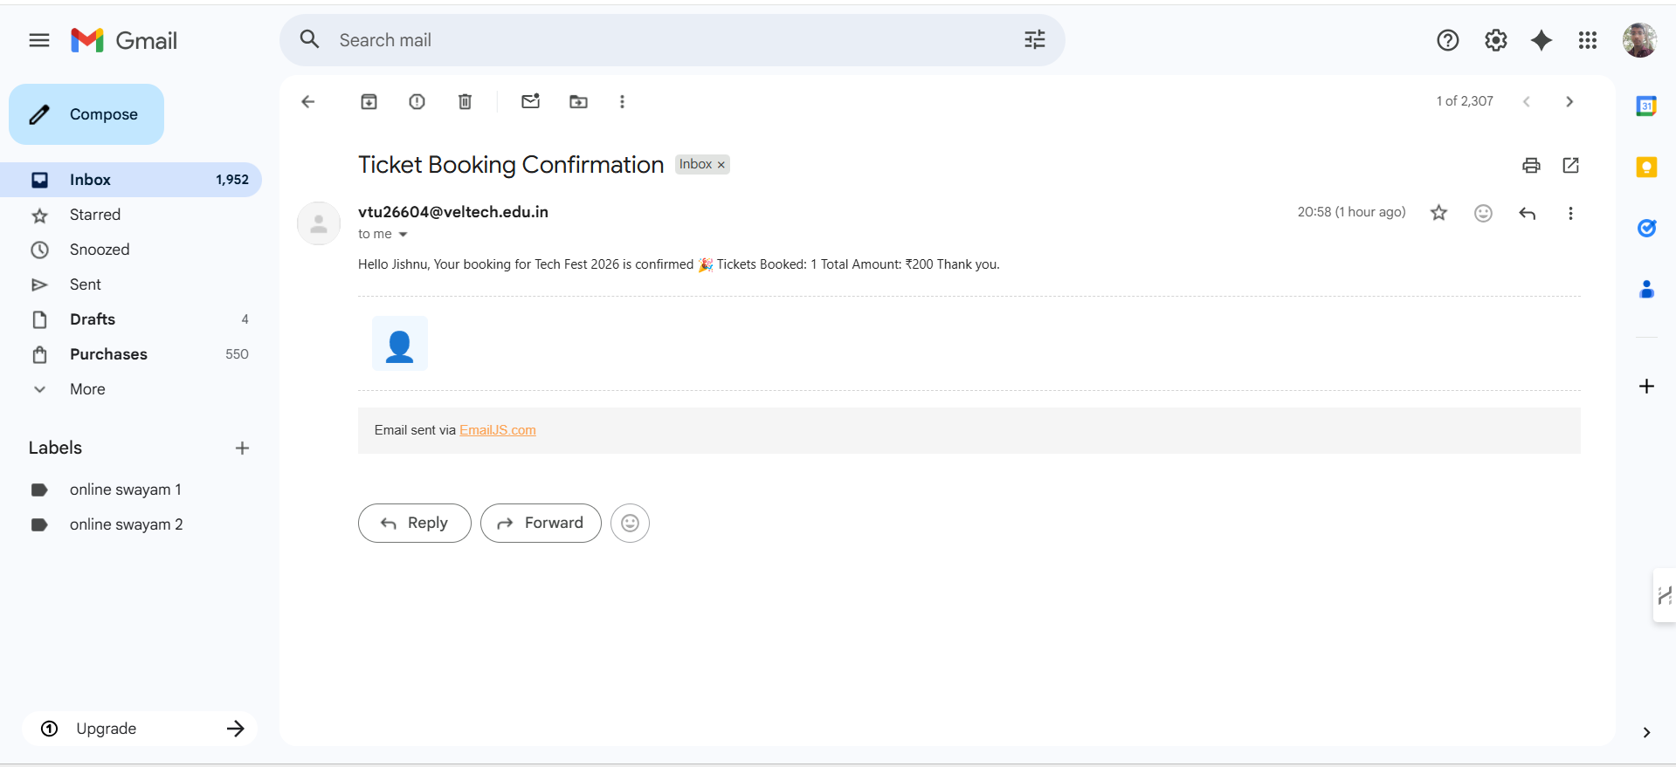
IMPLEMENTATION SCREENSHOTS
1
2
3
4
5
6
7
8
9

Slide 15
ADVANTAGES & LIMITATIONS
1
2
Advantages
Easy and user-friendly ticket booking system.
Saves time and reduces manual work.
Prevents overbooking of tickets.
Displays booking confirmation instantly.
Maintains booking history.
Limitations
Uses local storage instead of database.
Data is limited to one browser/device.
No advanced security features.
Not suitable for large-scale systems.
3
4
5
6
7
8
9

Slide 16
Thank you

